Slide 1

Telecommunication Churn Prediction
Presented By:
Adam Tuor
Aditya Parmar
Gurpreet Dhameja
Jasper Bowen Pang
Marco Teh

Slide 2

Agenda:
Project Overview w/ Questions to Ask
Dataset Terminology
Data Insights (powered by Power BI)
Machine Learning Modeling & Implementation
Demo Display

Slide 3

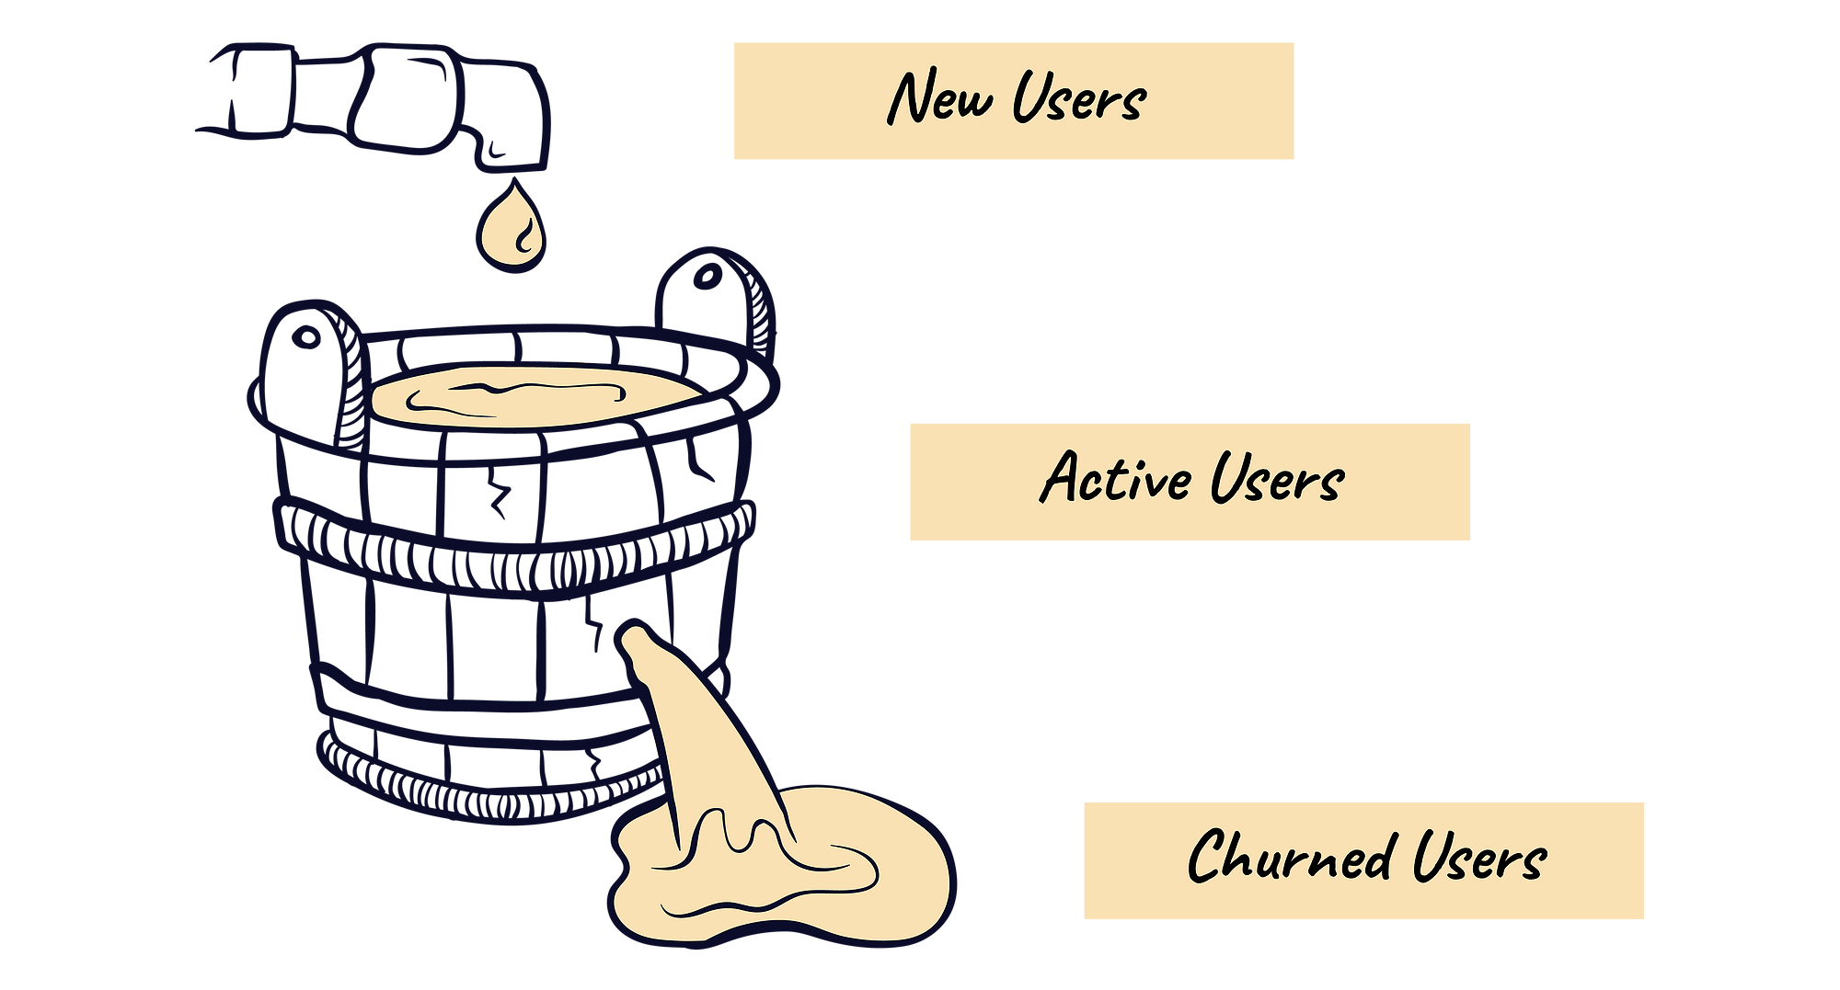
Project Overview
The percentage of customers who close their subscription with current internet service provider in any given period.
-> A high churn rate means you are not able to retain client.
The goal of our project is to predict if a person it’s likely going to churn based on comparably high accuracy machine learning model we generated.
Questions to ask:
- What does the demographic of our dataset look like?
- Is there any patterns/preferences in customer churn based on the type of service provided ?
- What Machine learning model is best to predict customer churn best ?
Notes:
What Machine learning model is best to predict customer churn best ?
Which features have most weight in determining customer churn rate ?
What patterns have in type of service has emerged and most common in customers that have churned ?
Is there any patterns/preferences in customer churn based on the type of service provided ?

Slide 4
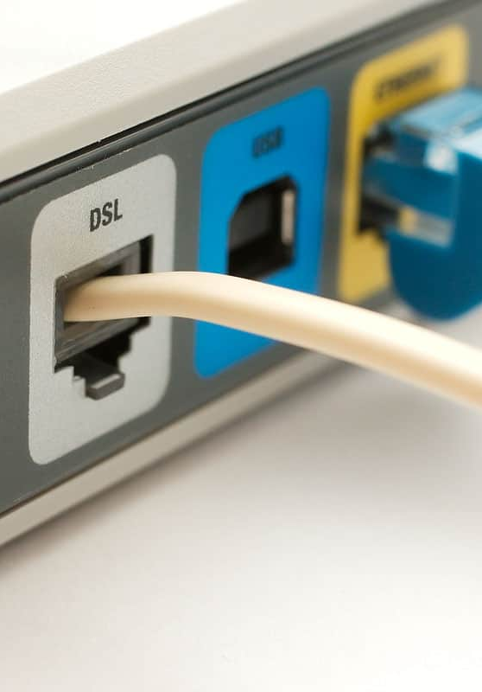

Dataset Terminology
Tenure
DSL
(Digital Subscriber Line)
Fiber Optic
Telecom Churn Rate
Number of months the customer has stayed with the company/provider
Fiber-optic communication is a method of transmitting information from one place to another by sending pulses of infrared or visible light through an optical fiber.
Customers who stop using services provided by subscriber-based services companies
A technology for the high-speed transmission of digital information over standard phone lines.

Slide 5
Process and Decision Making:
Brainstorm ideas
Finalizing Topic
Task Allocation
Data collection and cleansing
Machine Learning Model
HTML and CSS
Consolidate Contribution
Final Review
Power BI

Slide 6
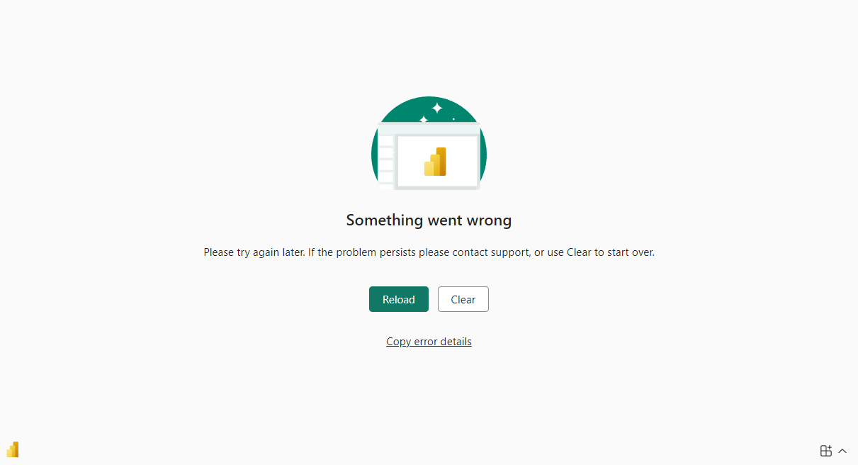
Data Insights:

Slide 7
Machine Learning :
Clean Data
Parameter Tuning
More Model Testing
Train/Test Split
Base Model Testing
More Tuning
OverSampler
Scale/Encode (Save these!)
Settle Due to Time Constraints

Slide 8
Implementation:
Extract
Transform
Load
Pull Data From Dash App
Convert
Scale/encode
Apply model
Predict
Load SHAP forceplot

Slide 9
Thank you

